Slide 1
Meat Processing in CO Or A Tale of Two Ribeyes
Miles Rollison - IGNITE 2018

Slide 2
Motivation
Difficulties with supply chain management for local differentiated meat products are what inspired me to apply to CSU DARE program
My own preferences for differentiated meat products are rarely satisfied by available options
I am interested in economic development strategies to regenerate and sustain rural communities, especially in the Mountain West region

Slide 3
Research Projects
Extension Risk Management Education
Assess financial and marketing risks associated with newer production techniques and marketing possibilities
Increase capacity within livestock food systems
Strengthen connections and communication among supply chain actors
CAS Pivot Project
Analyze the social and economic components of system for irrigated rotational grazing under development by Animal Sciences and Crop & Soil Sciences
Can these types of forage systems provide profitable alternative to traditional production and marketing enterprises for high-plains ranches?

Slide 4
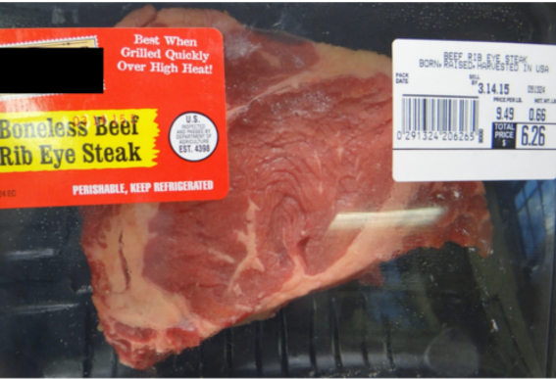
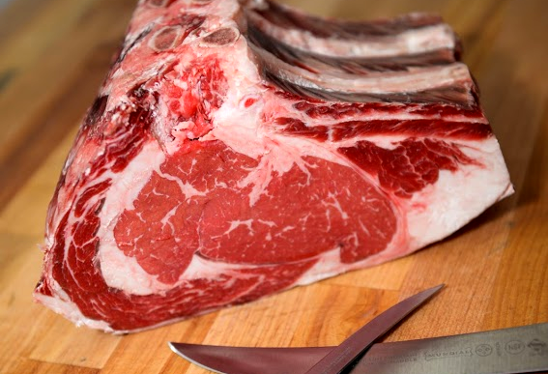
Which Ribeye would you rather eat?

Slide 5
Price : $9.49/lb
Cryovac for ?? Days
Resale Pack for ?? Days
Raised in USA
Harvested in USA
Price: $15.99/lb
21 Day Dry Aged
Raised on Pasture in Wellington, CO
Harvested in Weld County, CO
Cut to order

Slide 6
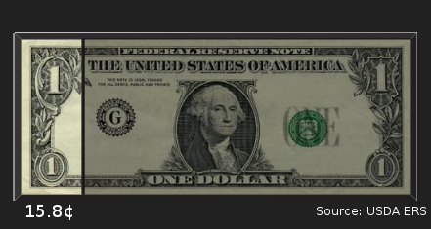
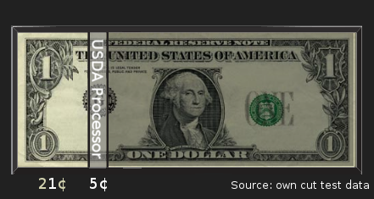
Notes:
100% Grass-Fed ~ 27.8c

Slide 7
Where can you buy this steak in Northern Colorado?

Slide 8
Short Term Research Goals
Examine structural factors that affect small meat processors in CO
Identify sources of high transaction costs to processors and producers that act as a barrier for growth
Gain better insight into consumer preferences for meat product attributes

Slide 9
Preliminary Research Questions
Is there a missing market for differentiated meat products in CO and if so what are the barriers preventing better market formation?
Will a two-sided market increase output for producers, throughput for processors, and choice for consumers, and if so what is the optimal form for such a market?
Will developing a robust local food system enable local producers to capture more economic surplus in non-local markets?

Slide 10
Standard Channel
Producer
CAFO
USDA
Processor
Warehouse
Producer
Retail /
Restaurant
Producer
Producer
Producer

Slide 11
Current Small Scale and Custom Processing
Producer
USDA
Processor
Producer at
Farmers Market
Producer
1
Custom
Processor
2
Producer
On Farm
Slaughter

Slide 12
Future Possibilities
Producer
Processor
Coop?
Firm?
App?
Nothing?
Retail /
Restaurant
Producer
Producer
Processor
Producer
Notes:
Niche Forage

Slide 13
Extension outcomes I hope to achieve
Diversify available market channels to reduce barriers to growth and provide options for better risk management strategies.
Identify regionally appropriate strategies for community economic development based on local comparative advantages
Determine an optimal level of cooperation, collective branding, etc. for small and mid-sized producers and processors.
Be able to buy the steak I want when I want without buying the rest of the cow and freezing it.
Notes:
Other Products (FV, Fibre, Malting Barley, etc)

Slide 14
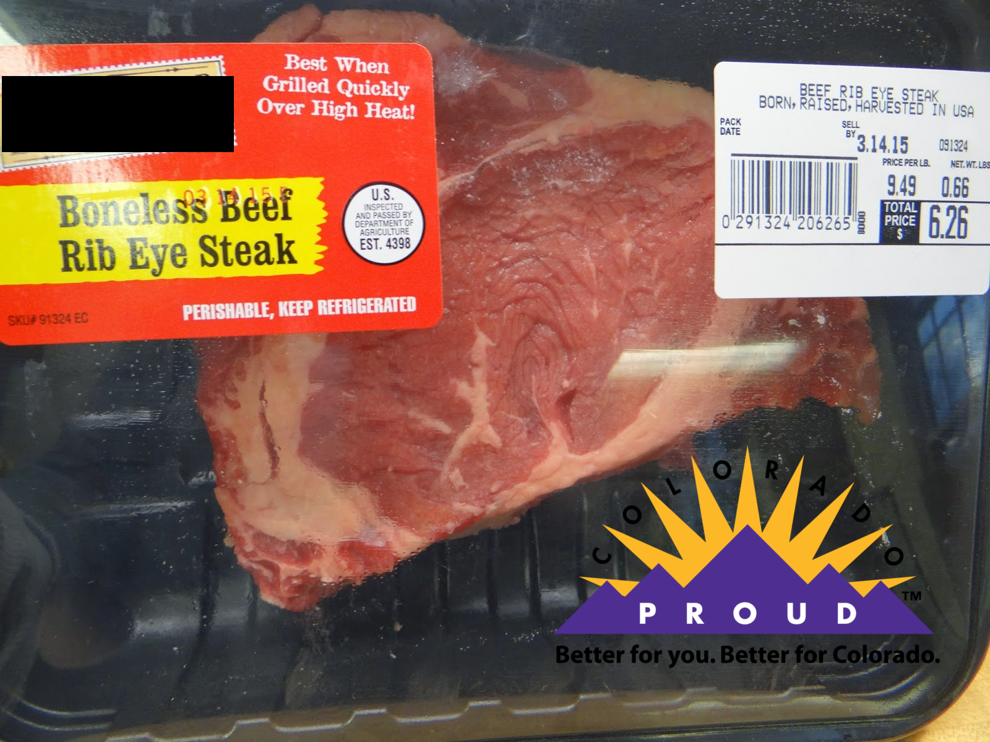
“BOTH / AND” Strategy
+

Slide 15
